Slide 1


Quantum Sensor Network Algorithms for Transmitter Localization
Caitao Zhan, Himanshu Gupta

Slide 2
Table of Content
Introduction & Motivation
Localization Problem Definition
Quantum Sensing Model
Methodology: Localization as Quantum State Discrimination
Improvement by Parameterized Quantum Circuit
Evaluation
Conclusion

Slide 3
1.1 Intro: Classical vs. Quantum Sensor
Classical sensor
Quantum sensor
Wireless sensor: RSS, CSI
Image sensor: visible light
Weather sensor: temperature, pressure, rainfall, wind
Single photon detector: capable of detecting a single photon
Quantum interferometer: phase change of light, gravitational wave
NV center: NV spin, magnetic field
Trapped ions: electric field
RF-photonic sensor: optical quadrature displacement
Notes:
CSI: channel properties of a communication link
superconducting nanowire single photon detector (SNSPD)

Slide 4
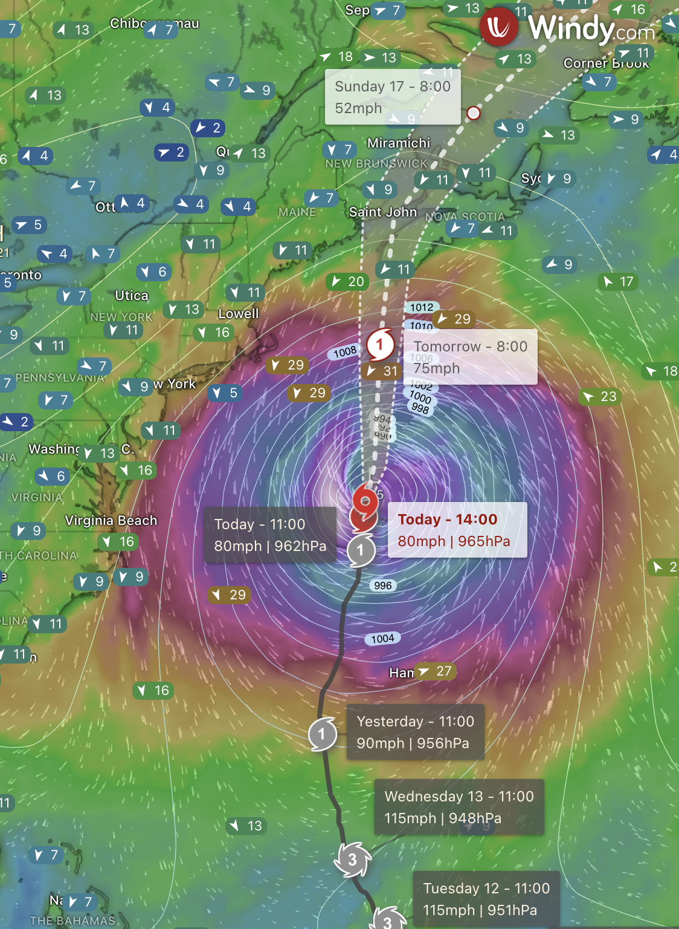
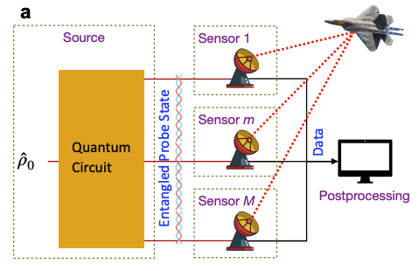
1.2 Intro: Network of Sensors
Very useful to have many sensors distributed geographically
(Zheshen Zhang & Quntao Zhuang, 2020)

Slide 5
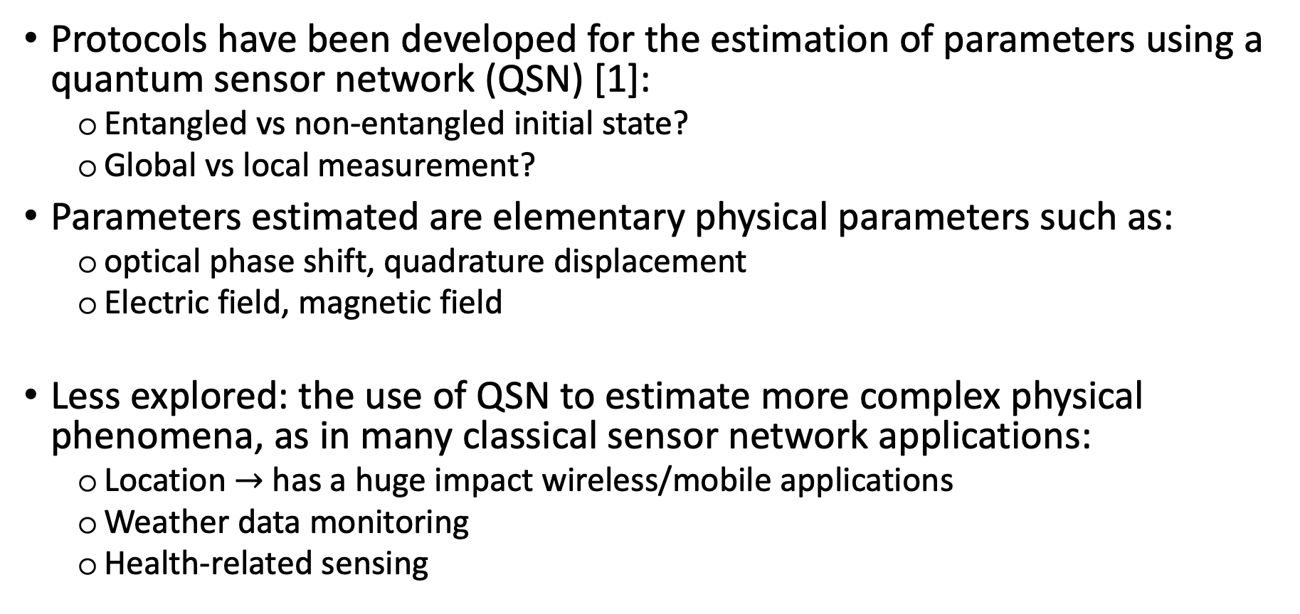
1.3 Motivation: TX Localization using QSN
Protocols have been developed for the estimation of parameters using a quantum sensor network (QSN) [1]:
Entangled vs non-entangled initial state?
Global vs local measurement?
Parameters estimated are elementary physical parameters such as:
optical phase shift, quadrature displacement
Electric field, magnetic field
Less explored: the use of QSN to estimate more complex physical phenomena, as in many classical sensor network applications:
Location $→$ has a huge impact wireless/mobile applications
Weather data monitoring
Health-related sensing
[1] Multiparameter Estimation in Networked Quantum Sensors, Timothy Proctor et al, PRL 2018

Slide 6
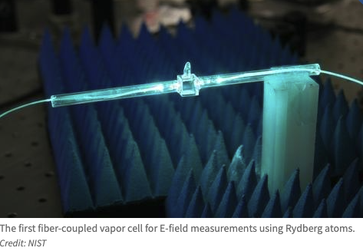
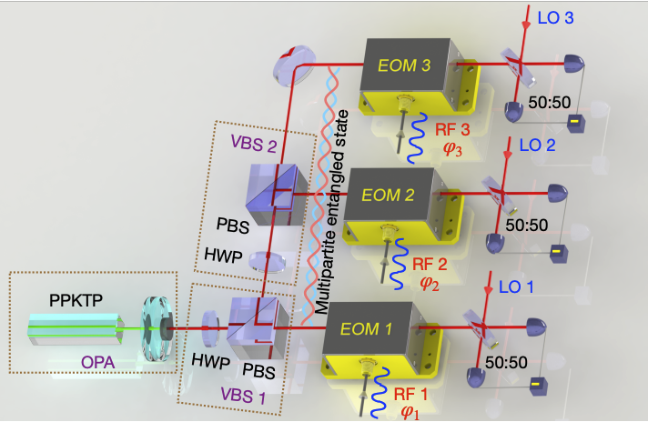
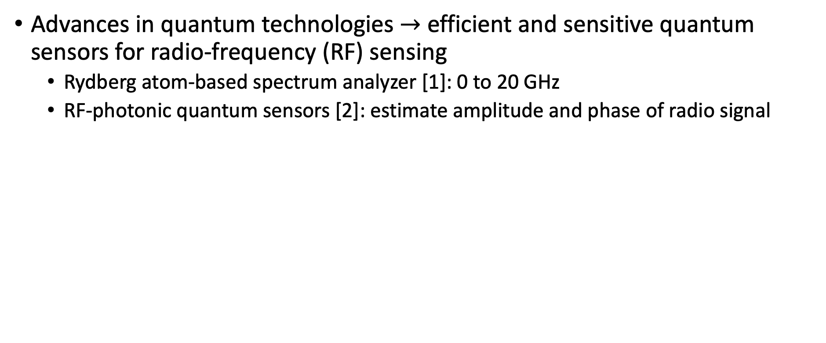
1.4 Motivation: TX Localization using QSN
Advances in quantum technologies $→$ efficient and sensitive quantum sensors for radio-frequency (RF) sensing
Rydberg atom-based spectrum analyzer [1]: 0 to 20 GHz
RF-photonic quantum sensors [2]: estimate amplitude and phase of radio signal
[1] Waveguide-coupled Rydberg Spectrum Analyzer from 0 to 20 GHZ, David Meyer et al, PR Applied 2023
[2] Demonstration of a reconfigurable entangled radiofrequency photonic sensor network, Yi Xia & Zheshen Zhang et al, 2020
Notes:
much more sensitive than the classical antenna-based RF sensors.

Slide 7
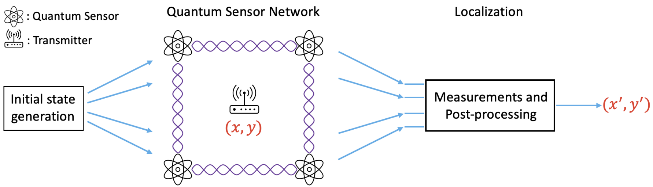
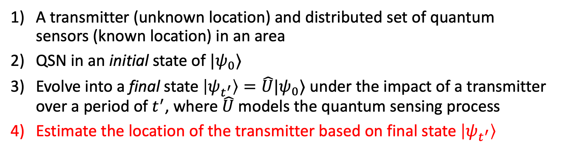
2.1 Problem Definition of TX Localization
A transmitter (unknown location) and distributed set of quantum sensors (known location) in an area
QSN in an initial state of $|ψ_{0}⟩$
Evolve into a final state $\left|ψ_{t^{′}}\right\rangle =\hat{U}|ψ_{0}⟩$ under the impact of a transmitter over a period of $t^{′}$, where $\hat{U}$ models the quantum sensing process
Estimate the location of the transmitter based on final state $\left|ψ_{t^{′}}\right\rangle$

Slide 8
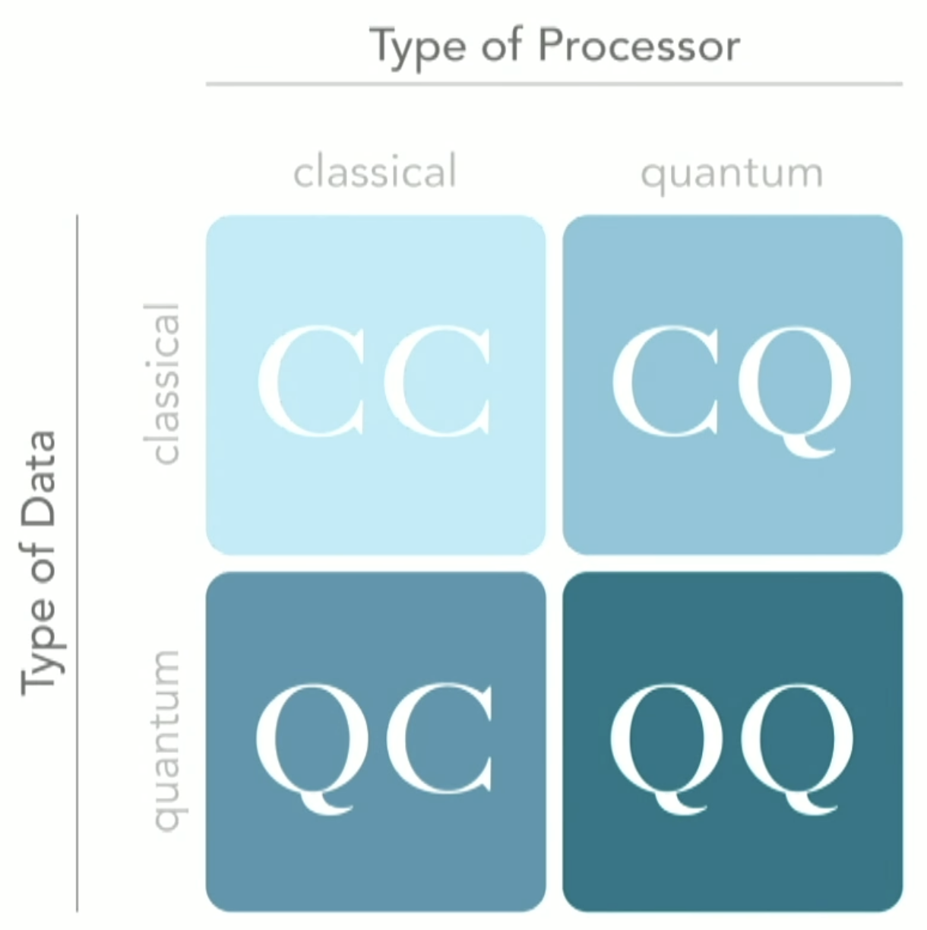
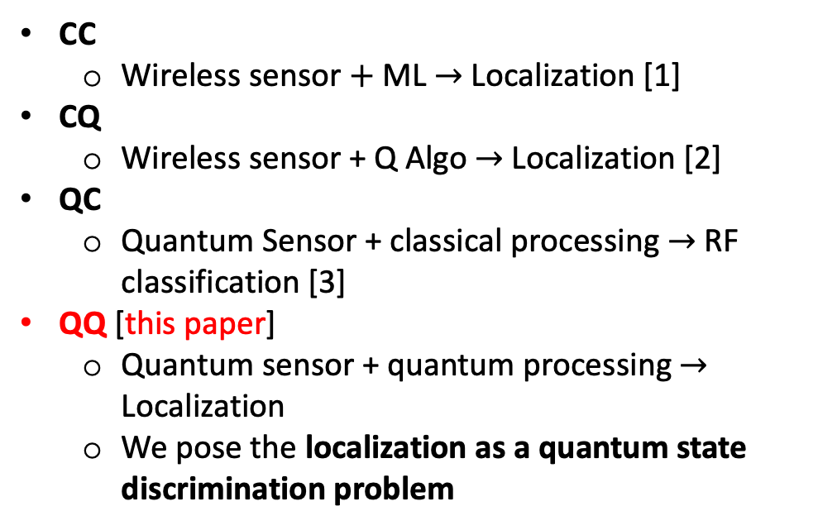
2.2 Related Work in Localization
CC
Wireless sensor $+$ ML $→$ Localization [1]
CQ
Wireless sensor + Q Algo $→$ Localization [2]
QC
Quantum Sensor + classical processing $→$ RF classification [3]
QQ [this paper]
Quantum sensor + quantum processing $→$ Localization
We pose the localization as a quantum state discrimination problem
[1] DeepMTL: Deep Learning Based Multiple Transmitter Localization, Caitao Zhan et al, IEEE WoWMoM 2021
[2] A Quantum Algorithm for RF-based Fingerprinting Localization Systems, A. Shokry & M. Youssef, IEEE QCE 2022
[3] Quantum-enhanced Data Classification with Variational Entangled Sensor Network, Yi Xia & Zheshen Zhang et al, PRX 2021
Notes:
Last years Google paper

Slide 9
2.3 More Related Work
“Discrete Outcome Quantum Sensor Networks”, Mark Hillery & Himanshu Gupta & Caitao Zhan, Physical Review A, 2023
Estimate discrete parameters
“Distributed Quantum Sensing Network with Geographically Constrained Measurement Strategies”, Yingkang Cao & Xiaodi Wu, IEEE ICASSP 2023
Local measurement
This work:
Assume global measurement and quantum communication
A first step of QSN towards real life application
Notes:
teleportation to central node

Slide 10


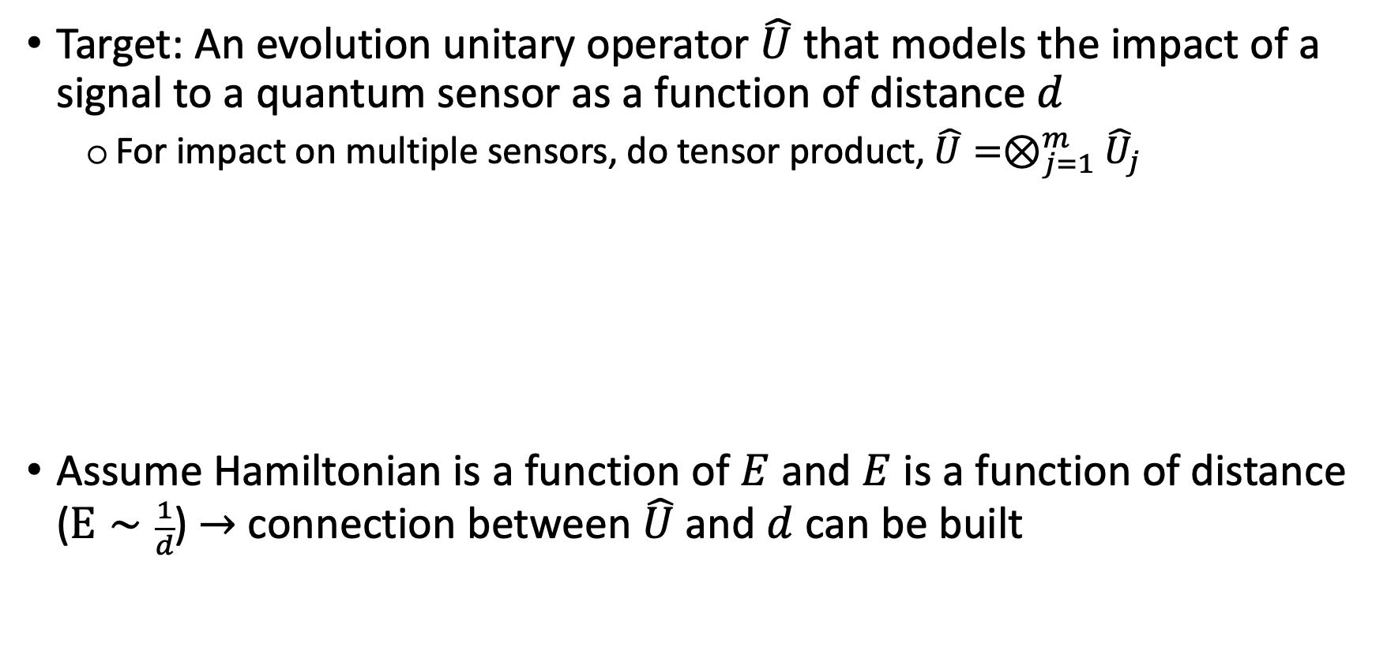
3.1 Quantum Sensing Model
Target: An evolution unitary operator $\hat{U}$ that models the impact of a signal to a quantum sensor as a function of distance $d$
For impact on multiple sensors, do tensor product, ${\hat{U}=⊗}_{j=1}^{m}{\hat{U}}_{j}$
Assume Hamiltonian is a function of $E$ and $E$ is a function of distance ($E∼\frac{1}{d}$) $→$ connection between $\hat{U}$ and $d$ can be built
Notes:
Intuition: The further the distance from the TX to the sensor, the weaker the impact from the TX to the sensor
The electric field amplitude ($E$) will decrease as the signal travels further in space

Slide 11
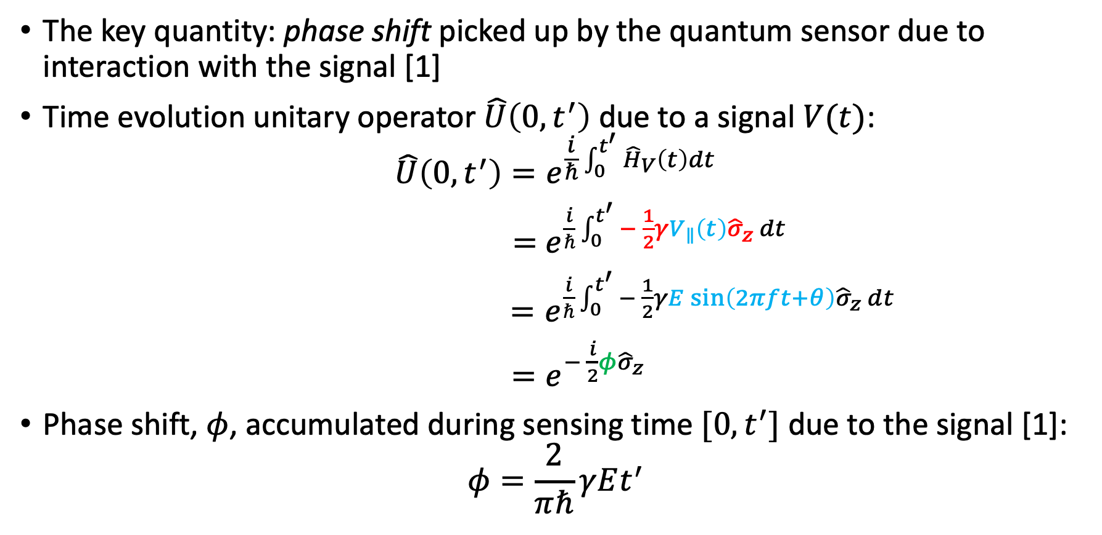
3.2 Quantum Sensing Model – Phase Shift
The key quantity: phase shift picked up by the quantum sensor due to interaction with the signal [1]
Time evolution unitary operator $\hat{U}\left(0, t^{′}\right)$ due to a signal $V(t)$:
$$\hat{U}\left(0, t^{′}\right)=e^{\frac{i}{ℏ}\int_{0}^{t^{′}}{{\hat{H}}_{V}\left(t\right)dt}}$$
$=$ $e^{\frac{i}{ℏ}\int_{0}^{t^{′}}{− \frac{1}{2}γV_{∥}\left(t\right){\hat{σ}}_{z} dt}}$
$=e^{\frac{i}{ℏ}\int_{0}^{t^{′}}{− \frac{1}{2}γE\sin\left(2πft+θ\right){\hat{σ}}_{z} dt}}$
$=e^{− \frac{i}{2}φ{\hat{σ}}_{z}}$
Phase shift, $φ$, accumulated during sensing time $[0, t^{′}]$ due to the signal [1]:
$$φ=\frac{2}{πℏ}γEt^{′}$$
[see paper for more detail]
[1] Quantum Sensing, C. Degen & F. Reinhard & P. Cappellaro, Review of Modern Physics 2017
Notes:
$γ$ is the coupling of the qubit to the signal

Slide 12
Table of Content
Introduction & Motivation
Localization Problem Definition
Quantum Sensing Model
Methodology: Localization as Quantum State Discrimination
Improvement by Parameterized Quantum Circuit
Evaluation
Conclusion

Slide 13
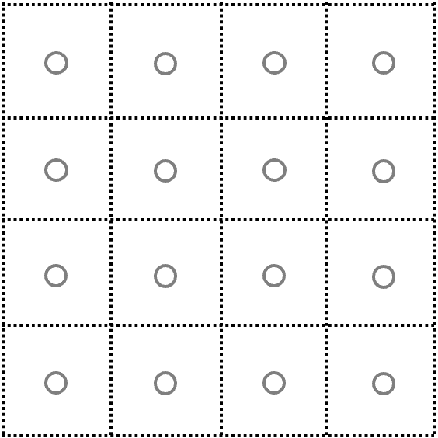
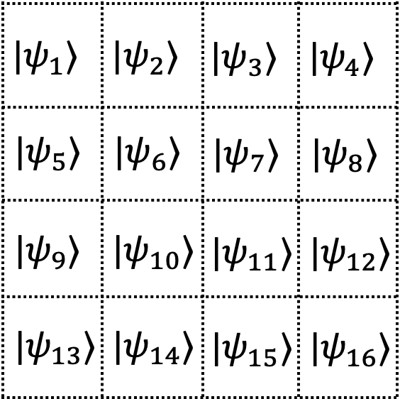
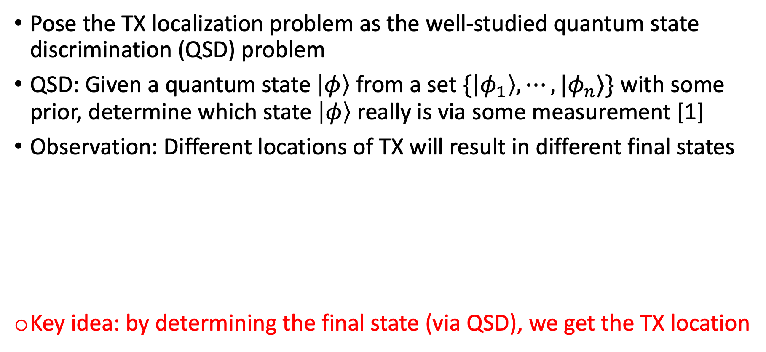
4.1 TX Localization as QSD
Pose the TX localization problem as the well-studied quantum state discrimination (QSD) problem
QSD: Given a quantum state $\left|φ\right\rangle$ from a set $\{\left|φ_{1}\right\rangle ,⋯, |φ_{n}⟩\}$ with some prior, determine which state $\left|φ\right\rangle$ really is via some measurement [1]
Observation: Different locations of TX will result in different final states
Key idea: by determining the final state (via QSD), we get the TX location
[1] Quantum State Discrimination and Its Applications, J. Bae, J. Phys. A: Math. Theor., 2015
Notes:
Underlies various applications in quantum information processing
Describes the distinguishability of quantum systems in different states, and the process extracting information from quantum system.

Slide 14
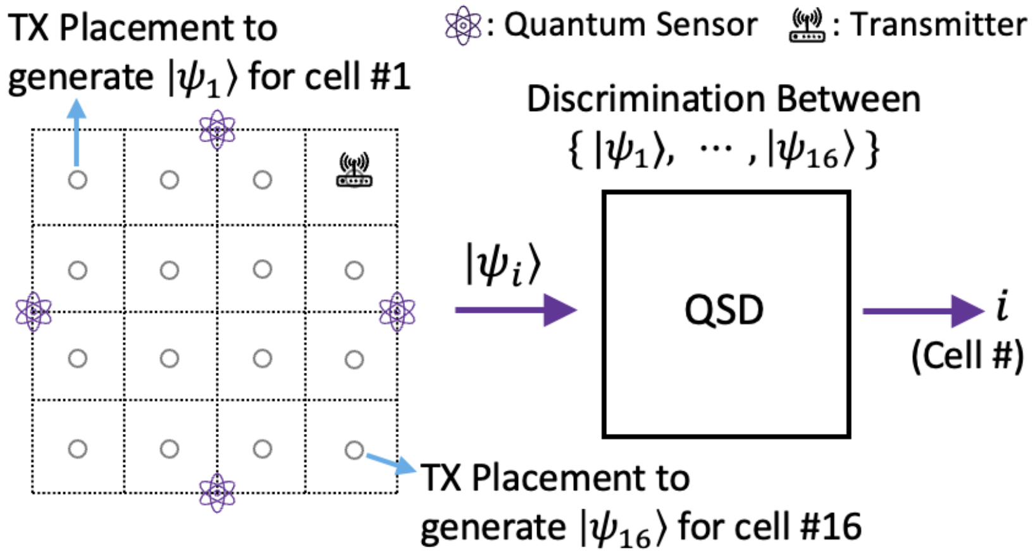
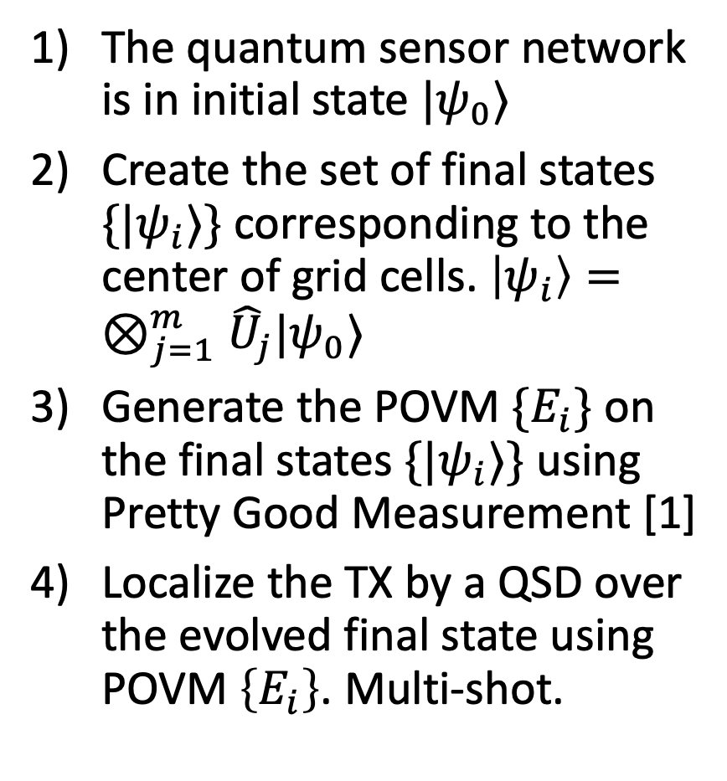
4.2 Basic One-Level QSD Method
The quantum sensor network is in initial state $|ψ_{0}⟩$
Create the set of final states $\{|ψ_{i}⟩\}$ corresponding to the center of grid cells. $\left|ψ_{i}\right\rangle =⊗_{j=1}^{m}{\hat{U}}_{j}|ψ_{0}⟩$
Generate the POVM $\{E_{i}\}$ on the final states $\{|ψ_{i}⟩\}$ using Pretty Good Measurement [1]
Localize the TX by a QSD over the evolved final state using POVM $\left\{E_{i}\right\}$. Multi-shot.
[1] A ’Pretty Good’ Measurement for Distinguishing Quantum States, Paul Hausladen et al, Journal of Modern Optics 1994

Slide 15
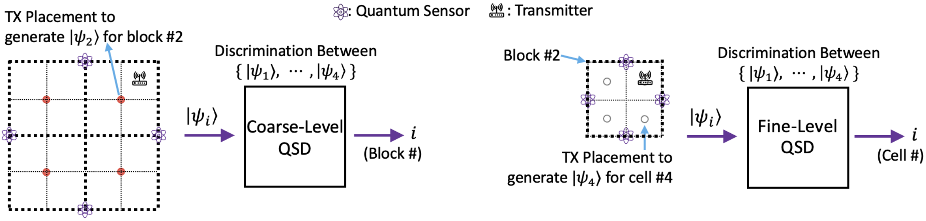
4.3 Improve: Two-level QSD Method
Challenges of the one-level QSD
High probability of error due to potential of many states (# of locations)
A global POVM measurement on large # of qubits (sensors) is hard
Propose a two-level QSD method
Coarse level determine a block, and fine level determine cell inside a block
Each level is a POVM on fewer # of final states and # of sensors

Slide 16
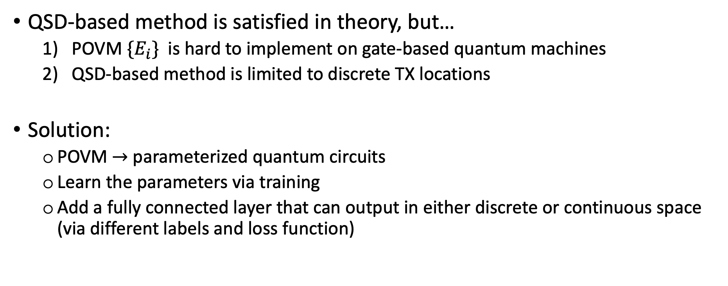
5.1 Improve: Parameterized Quantum Circuits
QSD-based method is satisfied in theory, but…
POVM $\{E_{i}\}$ is hard to implement on gate-based quantum machines
QSD-based method is limited to discrete TX locations
Solution:
POVM $→$ parameterized quantum circuits
Learn the parameters via training
Add a fully connected layer that can output in either discrete or continuous space (via different labels and loss function)
Notes:
High PoE: assign a single outcome to a set of target locations

Slide 17
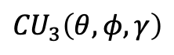
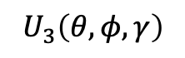
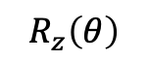
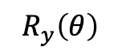
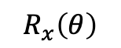
5.2 Parameterized Quantum Circuits (PQC)
PQC works well on NISQ machines
Regarded as machine learning models with remarkable expressive power
Common parameterized gates:
$$R_{x}\left(θ\right)$$
$$R_{y}\left(θ\right)$$
$$R_{z}\left(θ\right)$$
$$U_{3}\left(θ,φ, γ\right)$$
$${CU}_{3}\left(θ,φ, γ\right)$$
Notes:
Adaptability: The parameters in PQCs can be adjusted to tailor the circuit for a specific problem, allowing a single circuit structure to be repurposed for various tasks
Trainability: PQCs can be trained using classical optimization algorithms to solve optimization problems and machine learning tasks, making them a vital component of hybrid quantum-classical algorithms.
Noise: PQCs can be more robust against noise and errors in near-term quantum devices.

Slide 18
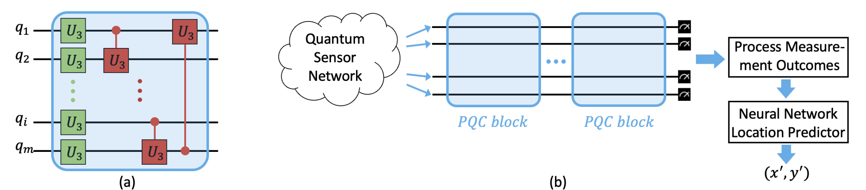
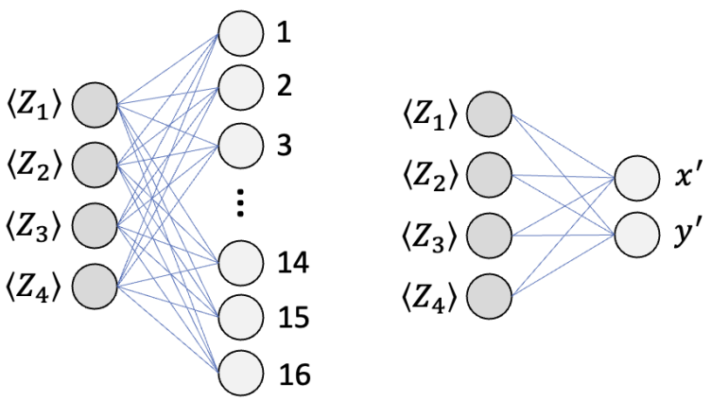
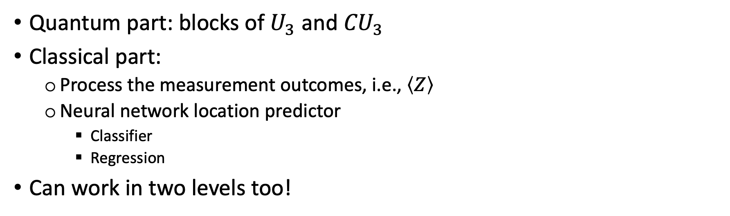
5.3 PQC-based Localization
Quantum part: blocks of $U_{3}$ and ${CU}_{3}$
Classical part:
Process the measurement outcomes, i.e., $\left\langle Z\right\rangle$
Neural network location predictor
Classifier
Regression
Can work in two levels too!
Notes:
measurement: compute the expected value of the z operator (measurement)
overall circuit with the Classifier component for the location prediction essentially equates to a circuit for quantum state discrimination (QSD), as the QSD problem also outputs a finite number of discrete outcomes
To output the predicted location in the continuous 2D space, we use a Regression Variant that outputs the location as an (x, y) point.

Slide 19

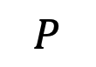
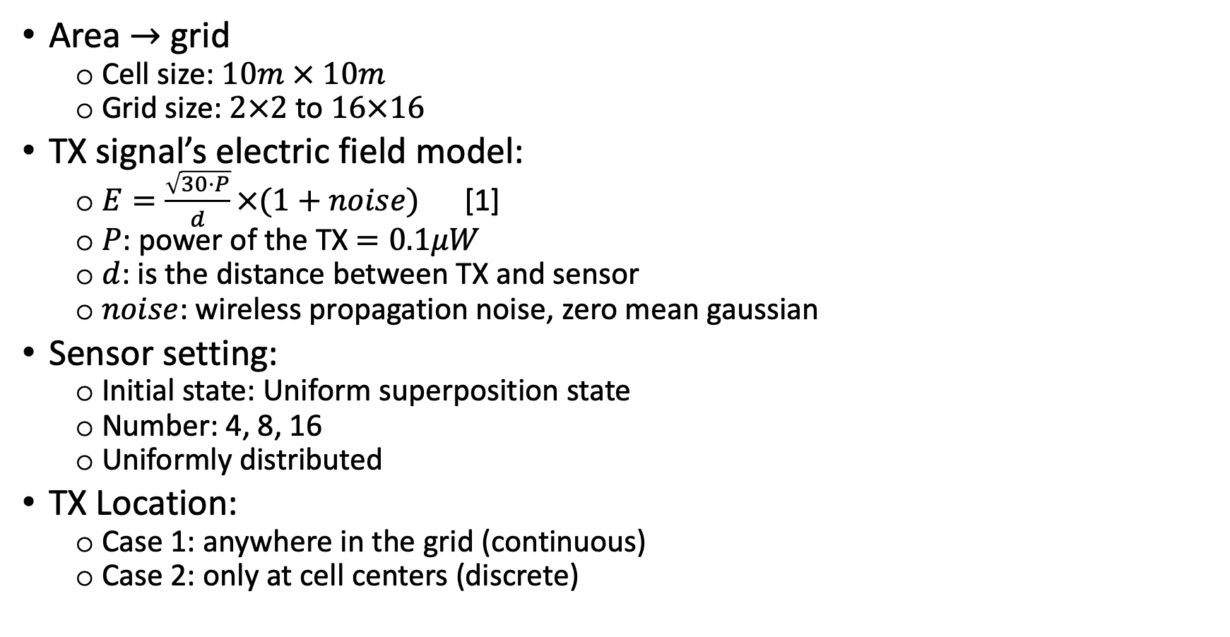

6.1 Evaluation Setting
Area $→$ grid
Cell size: $10m × 10m$
Grid size: $2×2$ to $16×16$
TX signal’s electric field model:
$E=\frac{\sqrt{30⋅P}}{d}×(1+noise)$ [1]
$P$: power of the TX $=0.1μW$
$d$: is the distance between TX and sensor
$noise$: wireless propagation noise, zero mean gaussian
Sensor setting:
Initial state: Uniform superposition state
Number: 4, 8, 16
Uniformly distributed
TX Location:
Case 1: anywhere in the grid (continuous)
Case 2: only at cell centers (discrete)
$$P$$
$$E$$
[1] Field strength meter, https://en.wikipedia.org/wiki/Field_strength_meter
Notes:
Evolution time = 1 ms
Less than one micro watt

Slide 20
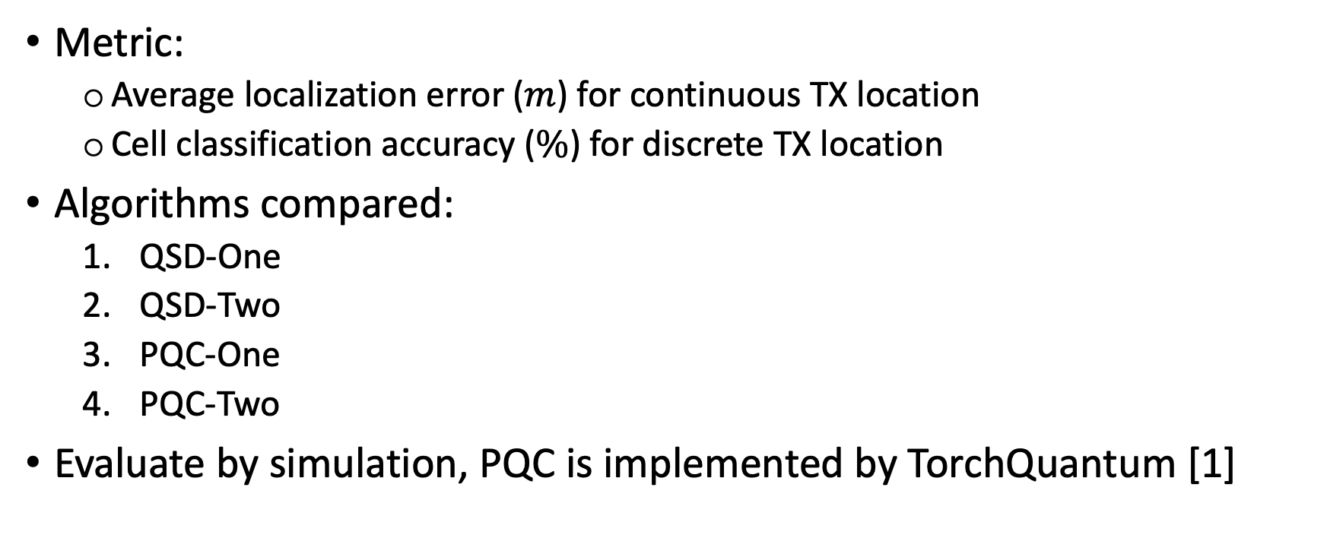
6.2 Evaluation Setting
Metric:
Average localization error ($m$) for continuous TX location
Cell classification accuracy ($\%$) for discrete TX location
Algorithms compared:
QSD-One
QSD-Two
PQC-One
PQC-Two
Evaluate by simulation, PQC is implemented by TorchQuantum [1]
[1] QuantumNAS: Noise-adaptive search for robust quantum circuits, Hanrui Wang et al, HPCA, 2022

Slide 21
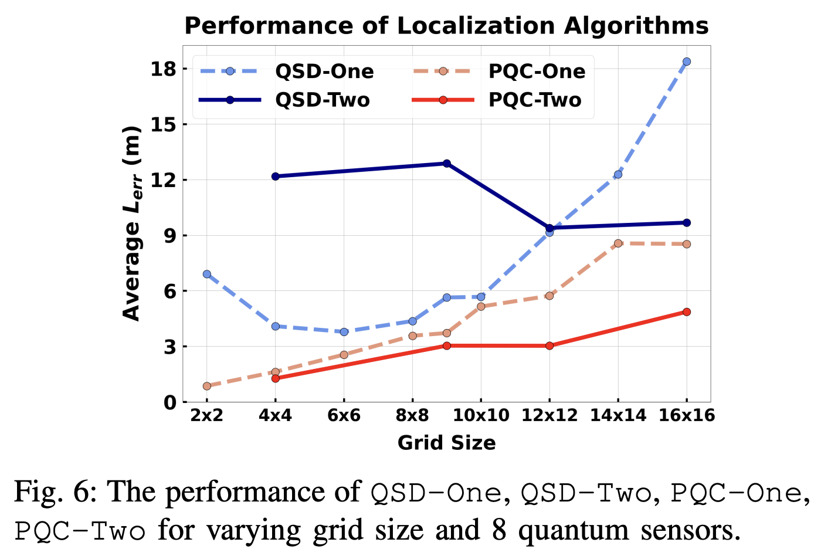
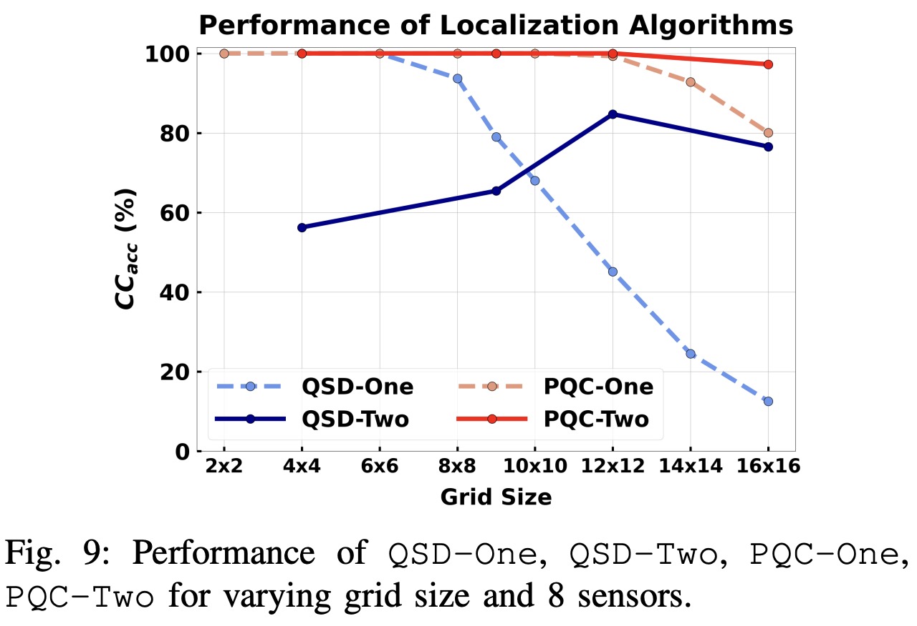
6.3 Evaluation Result
The PQC-based is better than QSD-based method
Two level approach can improve the localization performance

Slide 22
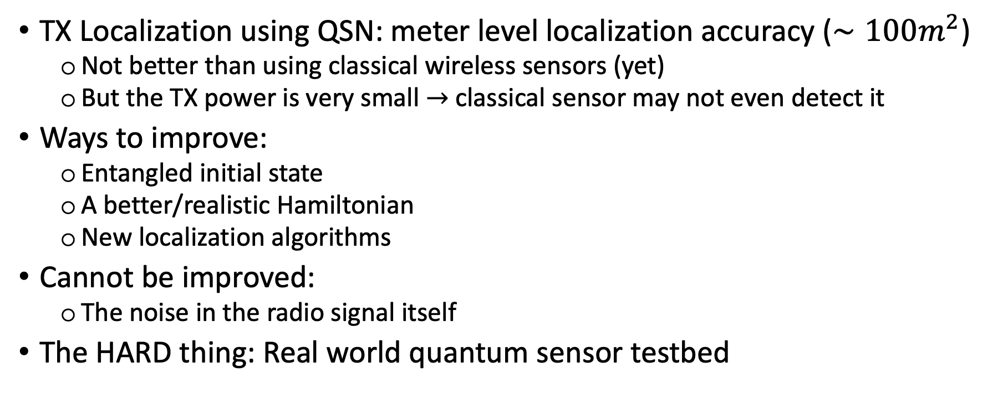
6.4 Discussion
TX Localization using QSN: meter level localization accuracy ($∼100m^{2}$)
Not better than using classical wireless sensors (yet)
But the TX power is very small $→$ classical sensor may not even detect it
Ways to improve:
Entangled initial state
A better/realistic Hamiltonian
New localization algorithms
Cannot be improved:
The noise in the radio signal itself
The HARD thing: Real world quantum sensor testbed

Slide 23
7 Conclusion
A first step using QSN in a real-world application – localization of TX
Model the TX localization problem as quantum state discrimination
Improvement via:
Two-level (coarse + fine) localization
Parameterized quantum circuit
Extensive evaluation via simulation
https://github.com/caitaozhan/QuantumLocalization
Thank you for listening!

Slide 24
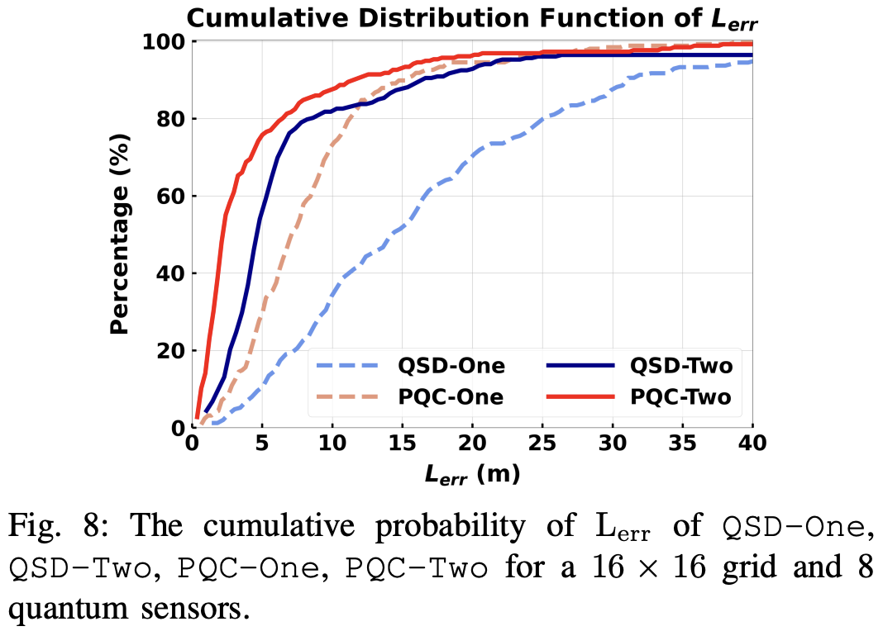
6.3 Evaluation Result – Continuous TX
The PQC-based is better than QSD-based method
Two level approach can improve the localization performance

Slide 25
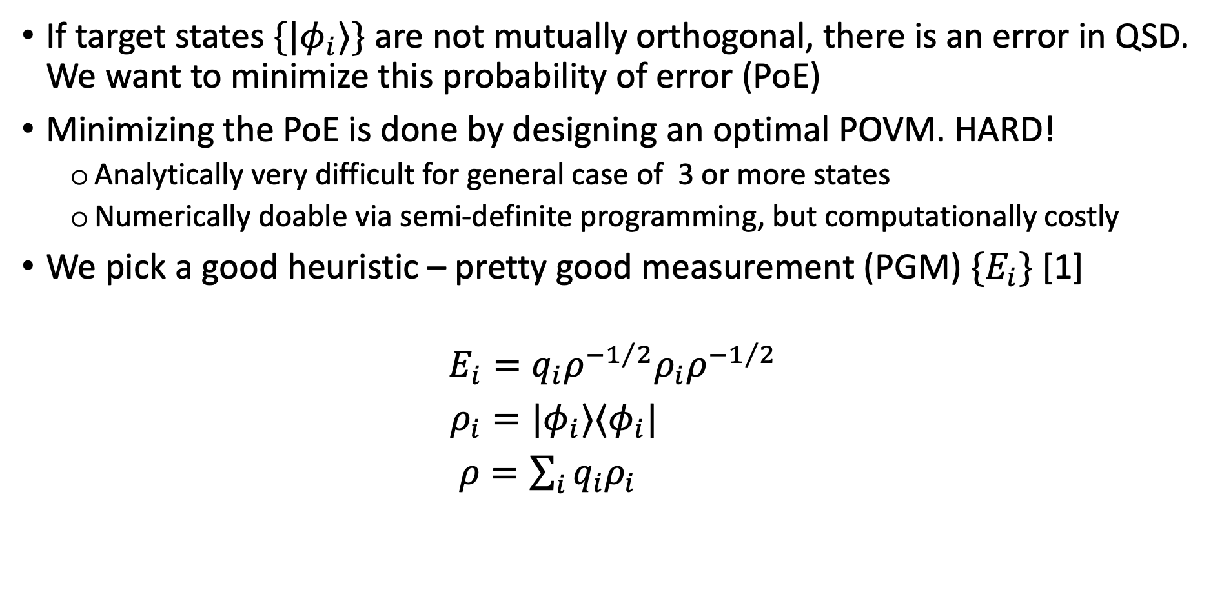
4.2 POVM: Positive-Operator Valued Measure
If target states $\{{|φ}_{i}⟩\}$ are not mutually orthogonal, there is an error in QSD. We want to minimize this probability of error (PoE)
Minimizing the PoE is done by designing an optimal POVM. HARD!
Analytically very difficult for general case of 3 or more states
Numerically doable via semi-definite programming, but computationally costly
We pick a good heuristic – pretty good measurement (PGM) ${\{E}_{i}\}$ [1]
$$E_{i}=q_{i}ρ^{−1/2}ρ_{i}ρ^{−1/2}$$
$ρ_{i}=|φ_{i}⟩⟨φ_{i}|$
$ρ=\sum_{i}{{q_{i}ρ}_{i}}$
[1] A ’Pretty Good’ Measurement for Distinguishing Quantum States, Paul Hausladen et al, Journal of Modern Optics 1994

Slide 26
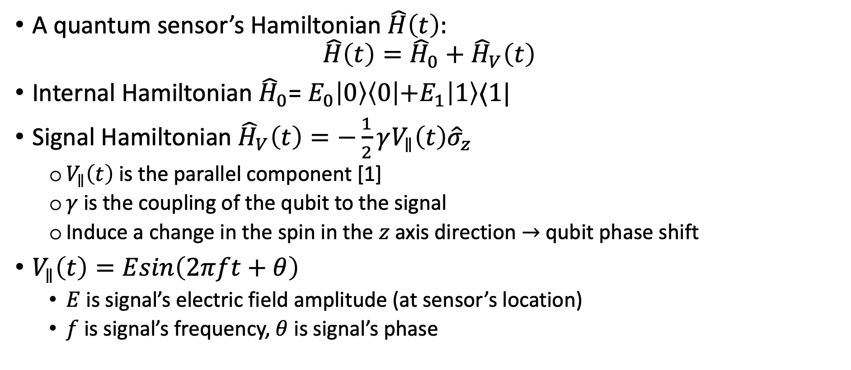
3.2 Quantum Sensing Model – Hamiltonian
A quantum sensor’s Hamiltonian $\hat{H}\left(t\right):$
$${\hat{H}\left(t\right)={\hat{H}}_{0}+\hat{H}}_{V}\left(t\right)$$
Internal Hamiltonian ${\hat{H}}_{0}$= $E_{0}\left|0\right\rangle \left\langle 0\left|+E_{1}\right|1\right\rangle ⟨1|$
Signal Hamiltonian ${\hat{H}}_{V}\left(t\right)=−\frac{1}{2}γV_{∥}\left(t\right){\hat{σ}}_{z}$
$V_{∥}\left(t\right)$is the parallel component [1]
$γ$ is the coupling of the qubit to the signal
Induce a change in the spin in the $z$ axis direction $→$ qubit phase shift
$V_{∥}\left(t\right)=Esin\left(2πft+θ\right)$
$E$ is signal’s electric field amplitude (at sensor’s location)
$f$ is signal’s frequency, $θ$ is signal’s phase
[1] A Mathematical Introduction to Quantum Sensing, Christopher Egerstrom
Notes:
Todo: explain why ignore the vertical component

Slide 27
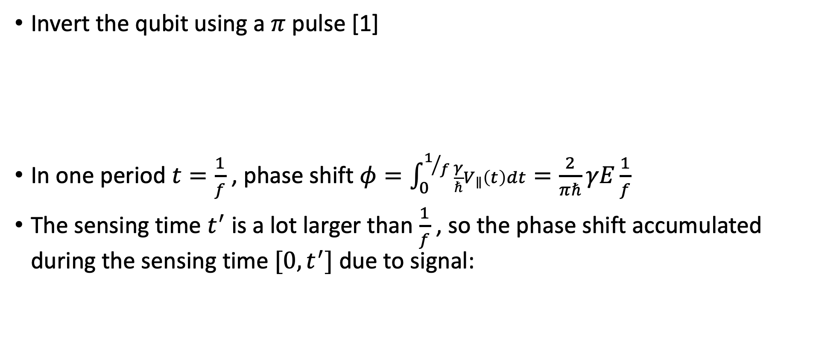

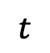
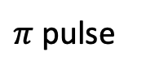
3.4 Quantum Sensing Model – Phase Shift
Invert the qubit using a $π$ pulse [1]
In one period $t=\frac{1}{f}$ , phase shift $φ=\int_{0}^{1/f}{\frac{γ}{ℏ}V_{∥}\left(t\right)dt=\frac{2}{πℏ}γE\frac{1}{f}}$
The sensing time $t^{′}$ is a lot larger than $\frac{1}{f}$ , so the phase shift accumulated during the sensing time $[0, t^{′}]$ due to signal:
$π$ pulse
$$t$$
$$t$$
$$φ=\frac{2}{πℏ}γEt^{′}$$
[1] Quantum Sensing, C. Degen & F. Reinhard & P. Cappellaro, Review of Modern Physics 2017

